Slide 1
Maryland Active Assailant
Interdisciplinary Work Group
May 14, 2026

Slide 2
Q2 Meeting Agenda
Call to Order
Subcommittee Updates
MCAC Current Events Update
TAK Working Group Update
Legislative Update
Recent & Upcoming Events
Member Roundtable
Action Item Review
Closing Remarks & Adjourn

Slide 3
Call to Order
Cpl. Mark Klinger, Co-Chair, MD AAIWG
Mr. Randy Linthicum, Co-Chair, MD AAIWG
  Introductions
  Approval of Meeting Minutes from February 26, 2026

Slide 4
Subcommittee Updates
First Responder Guidelines
Mass Casualty Support Services
Reminder – all voting members must participate on a subcommittee

Slide 5
First Responder Guidelines
Mr. Scott Haas, Queen Anne’s County
  Active Assailant Integrated Response (AAIR) Recommended Equipment List and Guidance for First Responders has been published!
    Replaces original Equipment Guidelines and Body Armor for EMS documents, to be updated on website
    ICS FOG re-development
      Previously discussed joint update – AAIWG will assist in technical review/SME capacity but will not author
  Next meeting: TBD
Notes:
Link to doc: Active Assailant Integrated Response Recommended Equipment List and Guidance for First Responders | Homeland Security

Slide 6
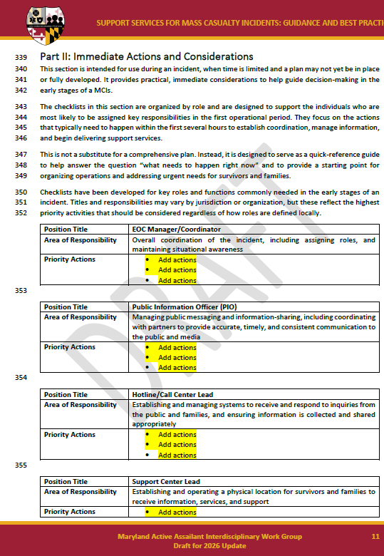
Mass Casualty Support Services
Ms. Cecilia Warren, MDoD
Ms. Rebecca Allyn, GOCPP
  Support Services for MCIs Guidance and Best Practices undergoing revamp
    ~50% draft was distributed 5/8
    Feedback due 5/22 using change table link or track changes/comments
  Next meeting: 5/27 at 10am

Slide 7
MCAC Current Events Update
Ms. Kaylee Bennett, MCAC
  Recent real-world events overview

Slide 8
TAK Working Group Update
Cpl. Mark Klinger, Co-Chair, MD AAIWG
  TAK Working Group formalization/organization updates

Slide 9
Legislative Updates
Ms. Emily Wesselhoff, MDEM
  Recent legislation updates/changes relevant to public safety and active assailant incidents

Slide 10
Recent & Upcoming Events
Cpl. Mark Klinger, Co-Chair, MD AAIWG
Mr. Randy Linthicum, Co-Chair, MD AAIWG
  MDEMA Conference
    May 26-29, 2026
  MCSS Conference
    July 22-23, 2026
    Need volunteers for AAIWG booth
      Set up: 7/21 (2p-5p) or 7/22 (6a-7a)
      Booth hours: 7/22 and 7/23 (7a-4p)
  Mid-Atlantic Life Safety
    Sept. 15, 2026
  2027 AAIWG Sympsoium
    TBD – Feb/Mar/Apr

Slide 11
Member Roundtable Discussion
Discussion of items of interest or concern from any voting member
  Request for keynote speaker recommendations for houses of worship security event sponsored by Baltimore City
Notes:
Whole group roundtable, NOT subcommittee report-outs.

Slide 12
Action Item Review
Cpl. Mark Klinger, Co-Chair, MD AAIWG
Mr. Randy Linthicum, Co-Chair, MD AAIWG

Slide 13
Closing Remarks
Cpl. Mark Klinger, Co-Chair, MD AAIWG
Mr. Randy Linthicum, Co-Chair, MD AAIWG

Slide 14
Adjourn
aaiwg.mdem@maryland.gov

