Slide 1
Maryland Active Assailant
Interdisciplinary Work Group
March 25, 2025

Slide 2
Q4 Meeting Agenda
Call to Order
Legislative Update
Subcommittee Updates
Symposium Recap
MCAC Current Events Update
Charter Next Steps
Recent & Upcoming Events
Member Roundtable
Action Item Review
Closing Remarks & Adjourn

Slide 3
Call to Order
Sgt. Travis Nelson, Co-Chair, MD AAIWG
Mr. Randy Linthicum, Co-Chair, MD AAIWG
  Introductions
  Approval of Meeting Minutes from December 3, 2024

Slide 4
Legislative Update
Ms. Anna Sierra, MDEM
  Recent legislative activity relevant to AAIWG

Slide 5
Subcommittee Updates
First Responder Guidelines
Emergency People Search & Recovery
Community Outreach/Website

Slide 6
First Responder Guidelines
Mr. Scott Haas, Queen Anne’s County
  Collaboration with National Urban Security Technology Laboratory - Big City Fire Working Group
  Next meeting: TBD - April

Slide 7
Emergency People Search & Recovery
Ms. Jennifer Gray, Tetra Tech
  Ms. Bethany Brown has moved to a new position at Dept of Aging
    Will be looking for a new Subcommittee Chair
  Support Services for MCI awareness-level training pilot
    1/16/25 in Crownsville - cancelled due to low registration
    Pilot held at Symposium
  Next meeting: TBD

Slide 8
Community Outreach/Website
Ms. Jennifer Gray, Tetra Tech
  Planned website updates/maintenance:
    Link check
    Add new resources
    Create AAIWG resources page
  Upcoming conferences:
    Maryland Center for School Safety: July 16 - 17 at Turf Valley
  Next meeting: TBD

Slide 9
Symposium Recap
Ms. Jennifer Gray, Tetra Tech
  27.5% no show rate:
    206 signed in, 84 badges left of the 305 printed
    2022 Event - 221 attended, 101 no shows (31% no show rate)

Slide 10
Top 5 Most Valuable Aspects
Keynote Speaker: many commended Ms. Schweit for her choice of topic, expertise, and presentation style
Networking: many saw considerable benefits of networking with fellow professionals in the same and related career fields
Breakout Sessions: attendees noted the benefit of the breakout rooms, particularly their Town Hall-type execution and effective use of space/tech
Symposium Content: quality and quantity of content offered during the various presentations and breakout rooms
Other: attendees noted various other benefits from the Symposium, including resources available to first responders, the benefits of exercising plans, and the importance of early detection and intervention to prevent mass violence

Slide 11
Top 5 Suggestions
School-specific Content: many expressed the need for information on school preparedness and response, particularly for non-security staff
Logistics: attendees expressed considerable dissatisfaction with the location due to traffic, rush hour, confusion regarding the venue address in relation to the parking garage, and availability of warm lunch options
Timeline: many responses indicated a preference for more breakout sessions (3 sessions rather than 2) by reducing the time allocated for the introduction of VIPs and the keynote address
Real World Experience/Case Studies: value in hearing from professionals directly involved in active assailant events and in reviewing case studies
Technology: few respondents requested access to presentation content to refer back to after the conclusion of the Symposium

Slide 12
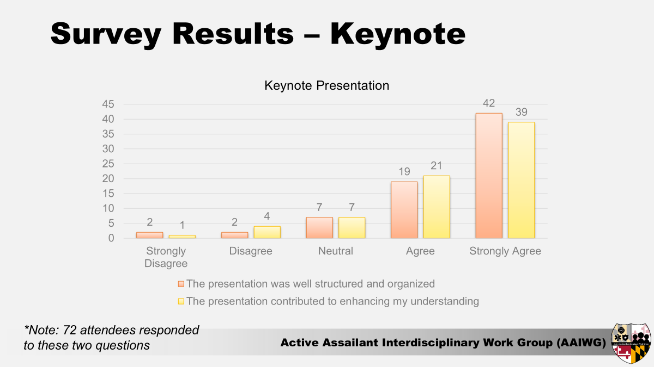

Slide 13
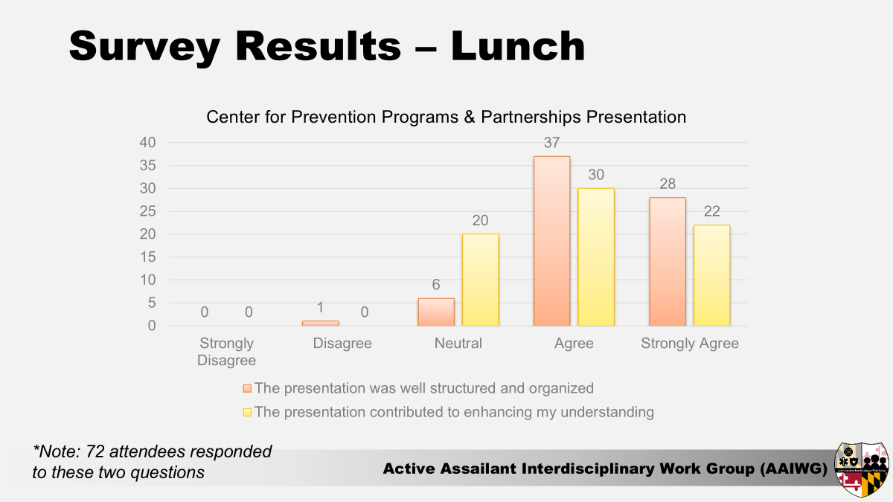

Slide 14
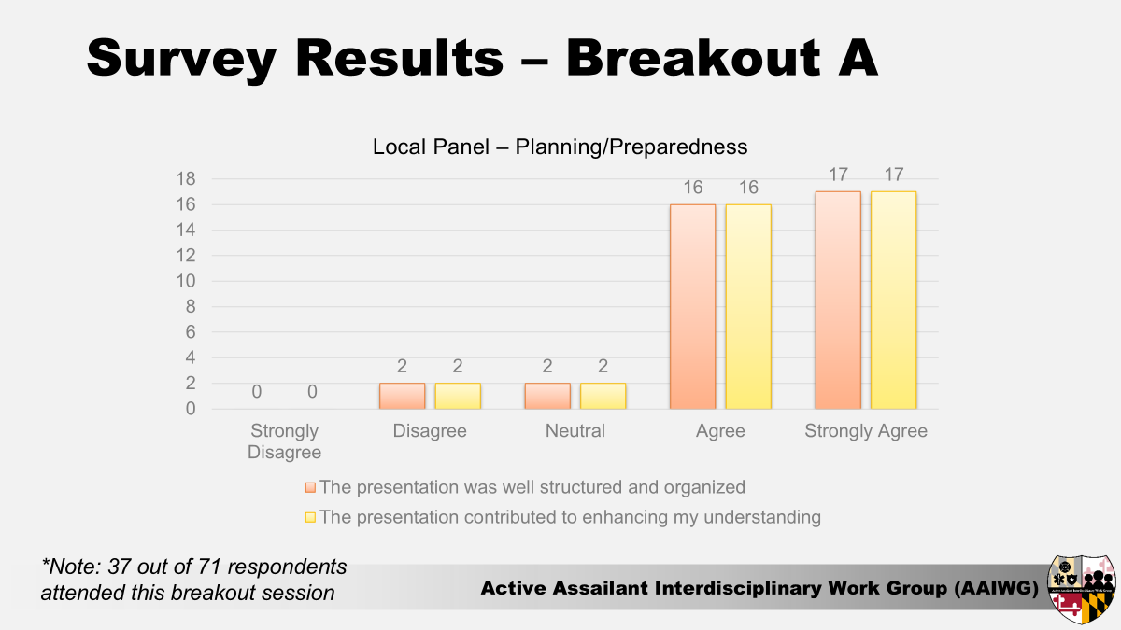

Slide 15
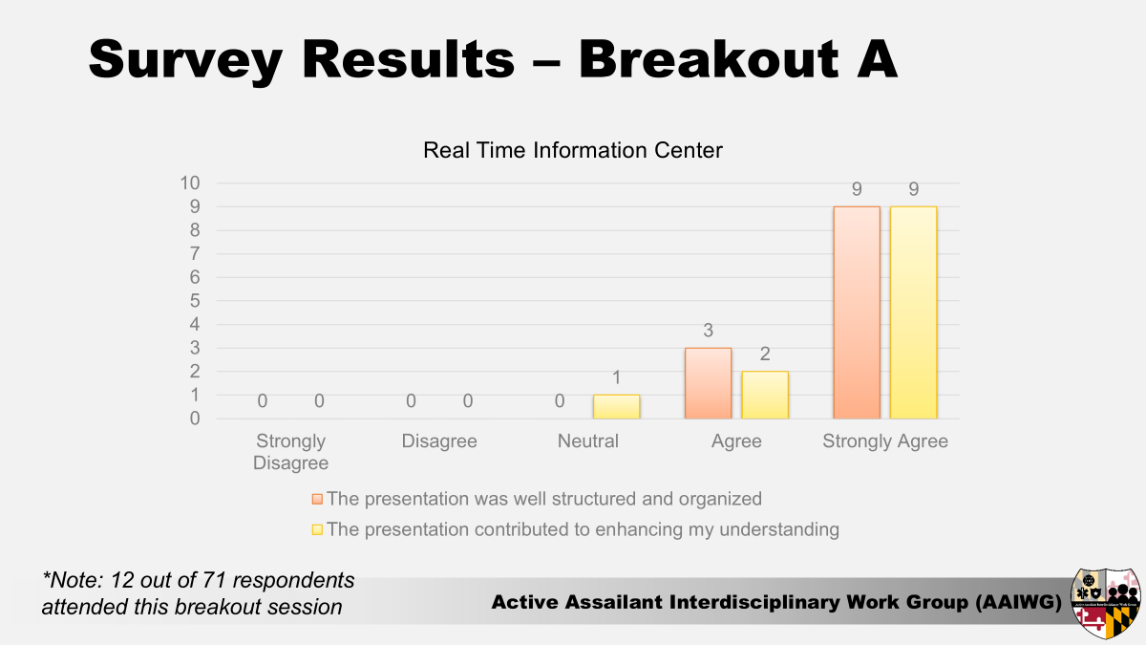

Slide 16
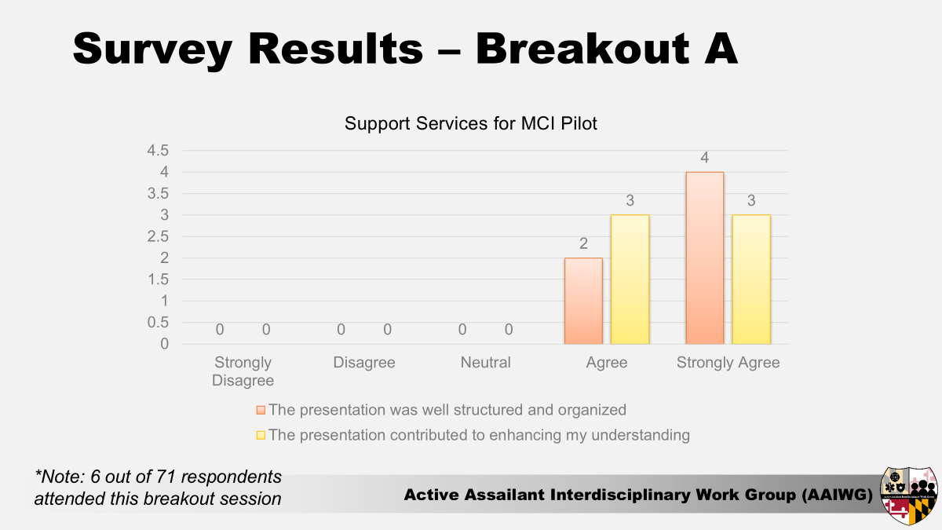

Slide 17


Slide 18


Slide 19
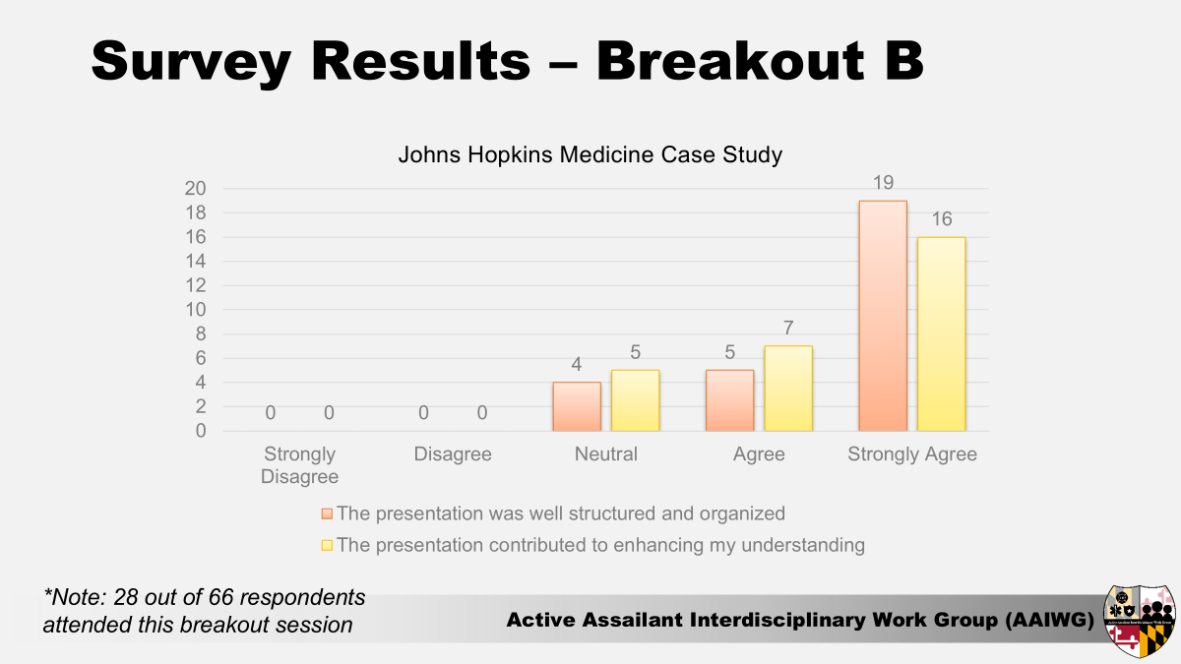

Slide 20
Symposium Recap
Ms. Jennifer Gray, Tetra Tech
  Planning Team Hotwash - Key Points
    Consider more generalized/high level working lunch topic
    Pre-symposium comms and registration worked well
    Shorten VIP introductions and/or extend the schedule for more breakout opportunities
    Consider Bowie State University for next Symposium
  AAIWG Feedback - open discussion

Slide 21
MCAC Current Events Update
Ms. Kaylee Bennett, MCAC
  Recent real-world events overview

Slide 22
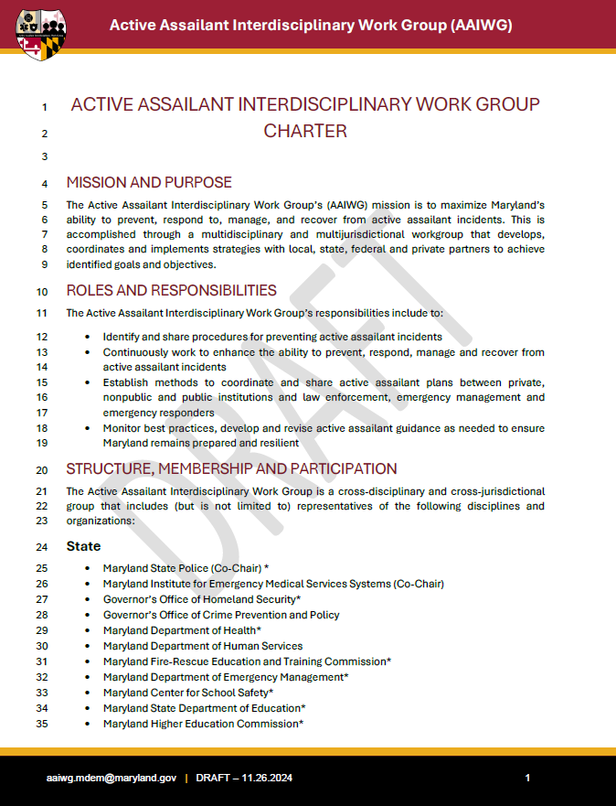
AAIWG Charter Update
Sgt. Travis Nelson, Co-Chair, MD AAIWG
Mr. Randy Linthicum, Co-Chair, MD AAIWG
  Finishing reconciling new charter with existing membership
  Appointment letters to be sent soon
  New charter will be in effect for Q2 meeting

Slide 23
Recent & Upcoming Events
Sgt. Travis Nelson, Co-Chair, MD AAIWG
Mr. Randy Linthicum, Co-Chair, MD AAIWG
  Maryland Center for School Safety (July 2025)
  National Homeland Security Conference (Aug 2025)
  Others?

Slide 24
Member Roundtable Discussion
Discussion of items of interest or concern from any voting member
Notes:
Whole group roundtable, NOT subcommittee report-outs.

Slide 25
Action Item Review
Sgt. Travis Nelson, Co-Chair, MD AAIWG
Mr. Randy Linthicum, Co-Chair, MD AAIWG

Slide 26
Closing Remarks
Sgt. Travis Nelson, Co-Chair, MD AAIWG
Mr. Randy Linthicum, Co-Chair, MD AAIWG

Slide 27
Adjourn
aaiwg.mdem@maryland.gov

