Slide 1
Maryland Active Assailant
Interdisciplinary Work Group
March 29, 2023

Slide 2
Agenda
Call to Order
Subcommittee Updates
MCAC Update
Legislative Update
Member Roundtable
Action Item Review
Closing Remarks & Adjourn

Slide 3
Call to Order
Sgt. Travis Nelson, Co-Chair, MD AAIWG
Mr. Randy Linthicum, Co-Chair, MD AAIWG
Introductions
Approval of Meeting Minutes from December 7, 2022

Slide 4
Subcommittee Update
Ms. Jennifer Gray, Contract Support - Tetra Tech
Ms. Katie Bryson, Contract Support - Tetra Tech
Emergency People Search & Recovery
Community Outreach/Website
First Responder Guidelines

Slide 5
Emergency People Search & Recovery
Training based on Guidance Document being developed
Draft slide deck provided to Subcommittee for review and feedback
Case studies being added
Pilot training delivery tentatively planned for summer
Long-term plan to record online training
Next meeting: April 19

Slide 6
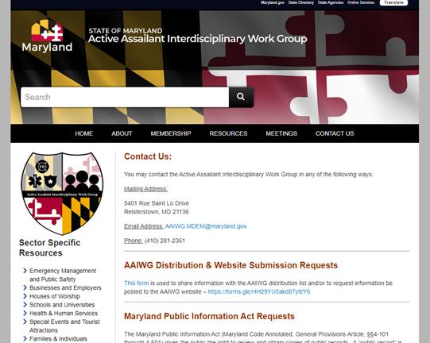
Community Outreach/Website
Completed Website Updates:
Add Support Services for MCIs document
Add Equipment Recommendations document
Update Subcommittees
Update Governor Hogan to Governor Moore
Announcements for new documents
Create standalone Contact Us page
Move PIA requests
Remove Symposium page

Slide 7
Community Outreach/Website
Interviews being conducted to identify engagement strategies and discuss:
Existing active assailant preparedness efforts
Barriers to preparedness activities
Best ways to communicate with stakeholders
Opportunities to engage with different stakeholder groups (webinars, meetings, conferences, etc.)
Topics of interest
Completed
Assoc. Campus Law Enforcement MD Dept of Disabilities Social Security Administration GOCPYVS University of Maryland Medical Center Archdiocese of Baltimore
Upcoming
Faith-Based ISAO MSDE Johns Hopkins MedStar

Slide 8
Community Outreach/Website
Upcoming Conferences:
MCSS
MDEMA
EMS Care
MD Crime Victim’s Rights
MSFA
Mid-Atlantic Life Safety
Looking for volunteers to support staffing a table at various conferences - GoogleSheet to sign up
Next meeting: March 31

Slide 9
First Responder Guidelines
Field Operations Guide (FOG) reviewed and updated
Groups with the opportunity to review:
Full AAIWG; MIEMSS JAC; Metro Chiefs; Local Emergency Managers
Feedback submissions received:
6 submissions from AACo PD, OCFD, FBI representatives
Revisions:
Clarifying language, minor content additions, ensuring NIMS-compliant language

Slide 10
First Responder Guidelines
Body Armor for EMS
Developing guidelines and recommendations document similar to Equipment document
Purchasing Considerations
When to Wear
Familiarization & Use Best Practices
Training & Exercise Recommendations
Legal Guidance/Obligations
Template for Policy
Next meeting: TBD - late April

Slide 11
MCAC Briefing
Ms. Jessica Curtis, Senior Intelligence Analyst, MCAC
Overview of recent active assailant incidents and successful prevention activities

Slide 12
Legislative Update
Ms. Sabrina Chase, Legal Counsel
Overview of legislative activity related to active assailant incident preparedness, response and prevention

Slide 13
Member Roundtable Discussion
Discussion of items of interest or concern from any voting member
Notes:
Whole group roundtable, NOT subcommittee report-outs.

Slide 14
Action Item Review
Sgt. Travis Nelson, Co-Chair, MD AAIWG
Mr. Randy Linthicum, Co-Chair, MD AAIWG

Slide 15
Closing Remarks
Sgt. Travis Nelson, Co-Chair, MD AAIWG
Mr. Randy Linthicum, Co-Chair, MD AAIWG

Slide 16
Adjourn
aaiwg.mdem@maryland.gov

